Slide 1
RAPId api
Anirudh G
245099

Slide 2
What is rapid api
It is a market places for API’s
Provided by Microsoft and it cracks 10k API’s
Rapid Api is a market place where we can find and connect to API as a consumer.

Slide 3
Difference Steps
STEP 1
URL:-https://rapidapi.com/

Slide 4
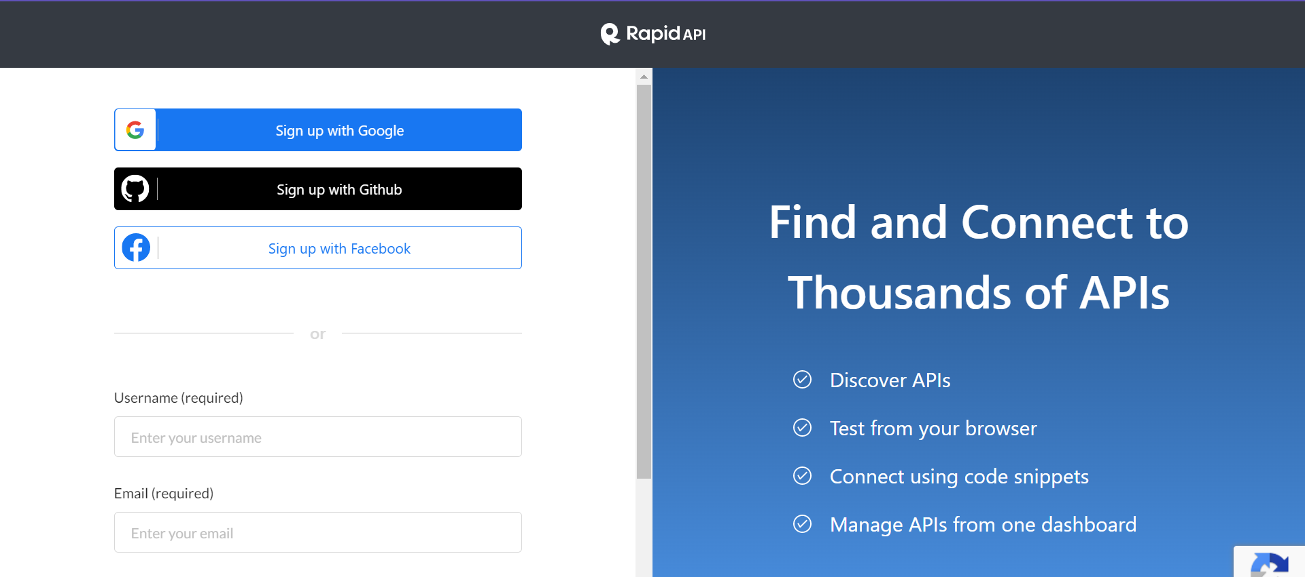
Step 2
LOGIN/SIGNUP

Slide 5
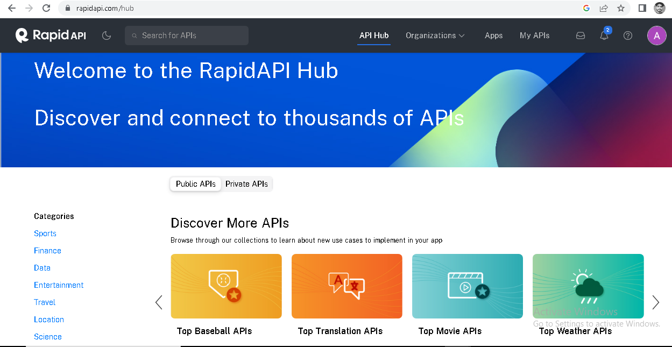
Step3
MAIN PAGE
”

Slide 6
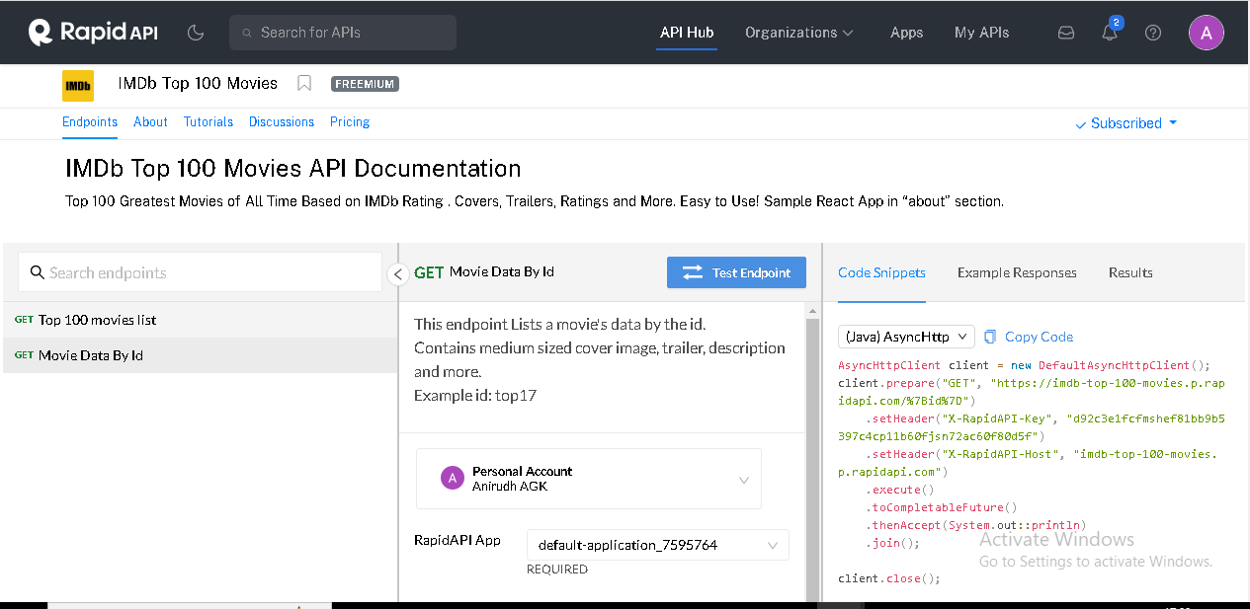
example

Slide 7
References
GitHub Link:
https://github.com/AnirudhUST/SpringBootRapidApi
Youtube Link:
https://www.youtube.com/watch?v=ViaBzK11EkE
Website Link:
https://rapidapi.com/

Slide 8
THANK YOU

